Slide 1
Outline
PTH function and other basics
Osteoblast
Osteoclast
Bone remodelling
Osteoporosis
Teriparatide pharmacology
Clinical overview
Place in therapy
Comparison
Guidelines
Teriparatide in Nephrology
Teriparatide in Rheumatology
Take home message

Slide 2
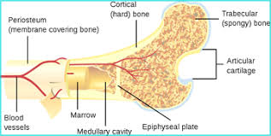
Bone structure

Slide 3
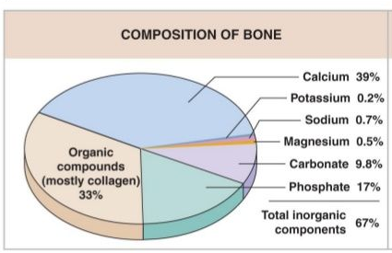
Bone structure

Slide 4
PTH
Parathyroid hormone or parathormone
Secreted by Parathyroid glands
Controls the level of calcium in the blood
Inhibits osteoblast activity and stimulates osteoclast activity leading to bone breakdown and calcium release.

Slide 5
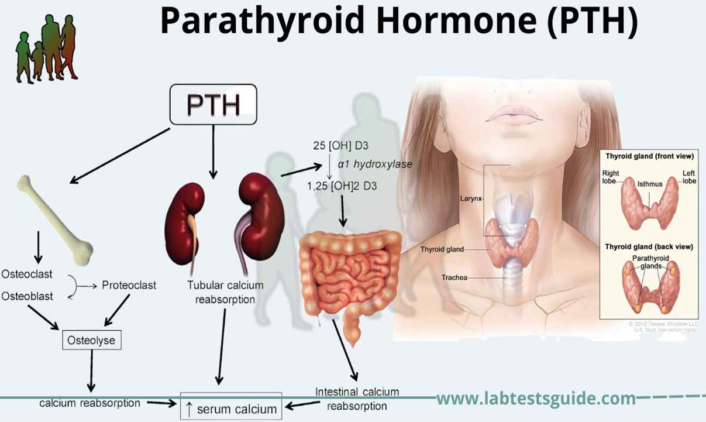

Slide 6
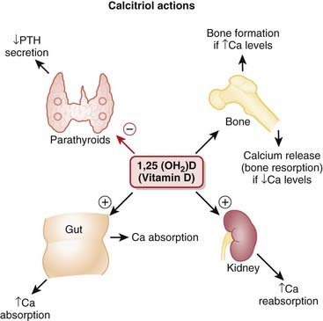
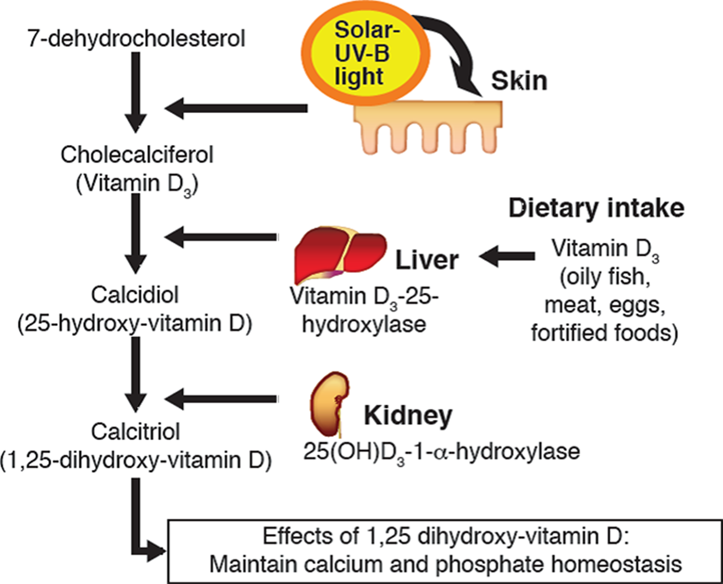
Vit-D3

Slide 7
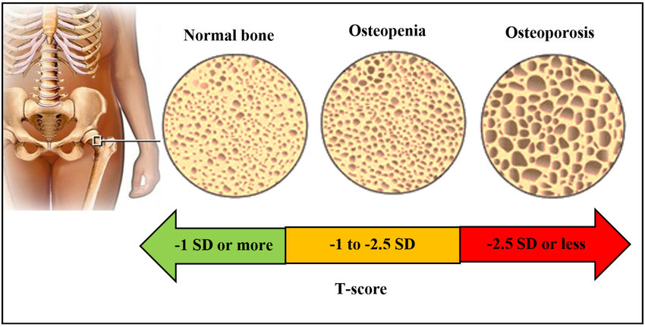
Osteoporosis
Osteoporosis is a bone disease that develops when bone mineral density and bone mass decreases, or when the quality or structure of bone changes.

Slide 8
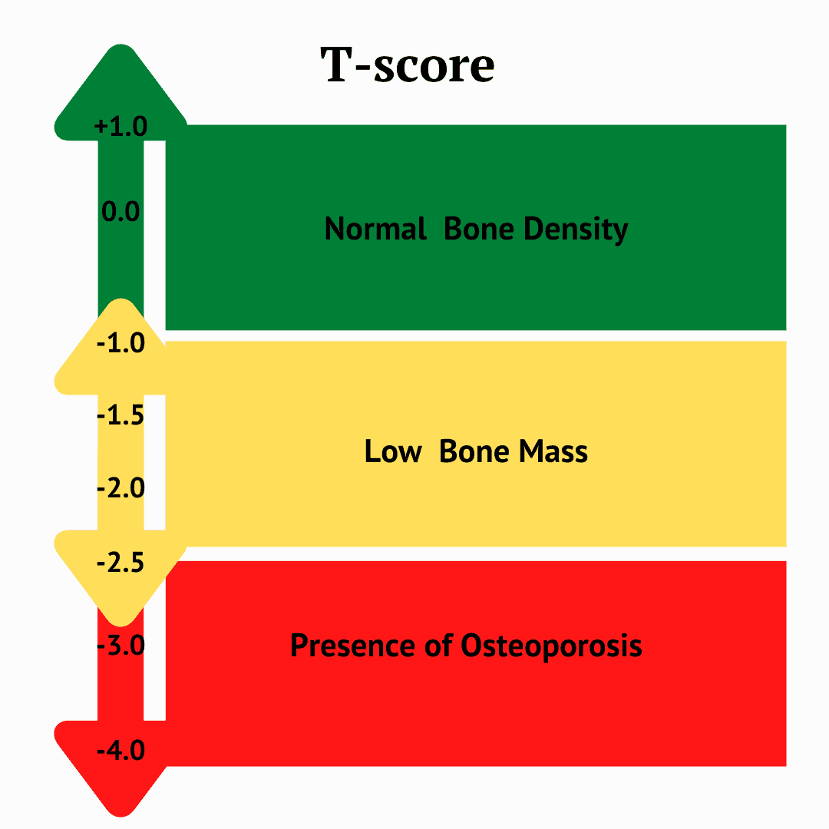
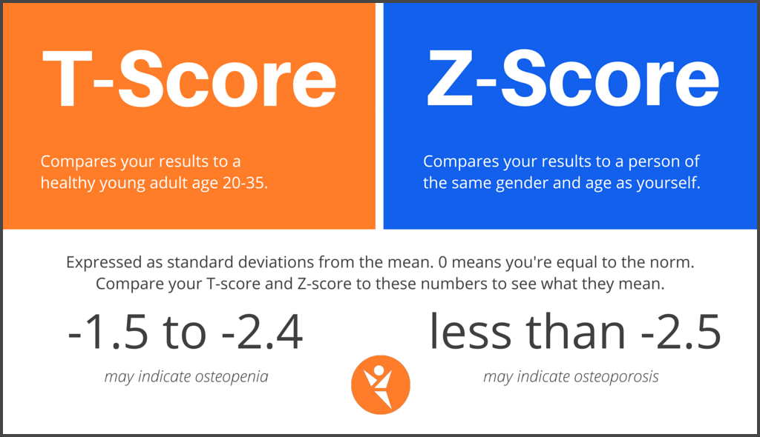
Osteoporosis

Slide 9
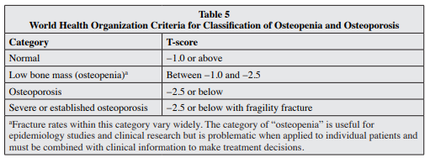

Slide 10
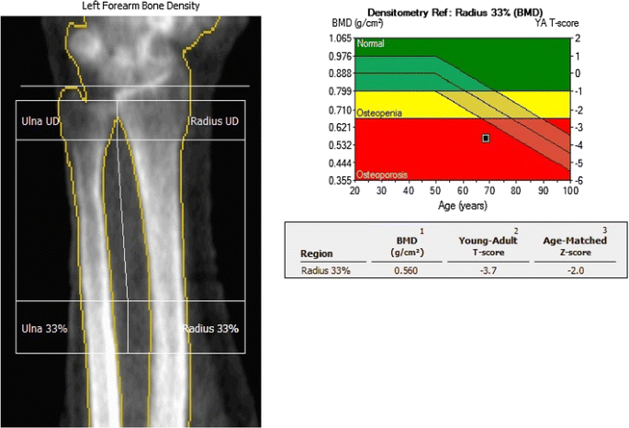
DEXA Scan dual-energy X-ray absorptiometry

Slide 11
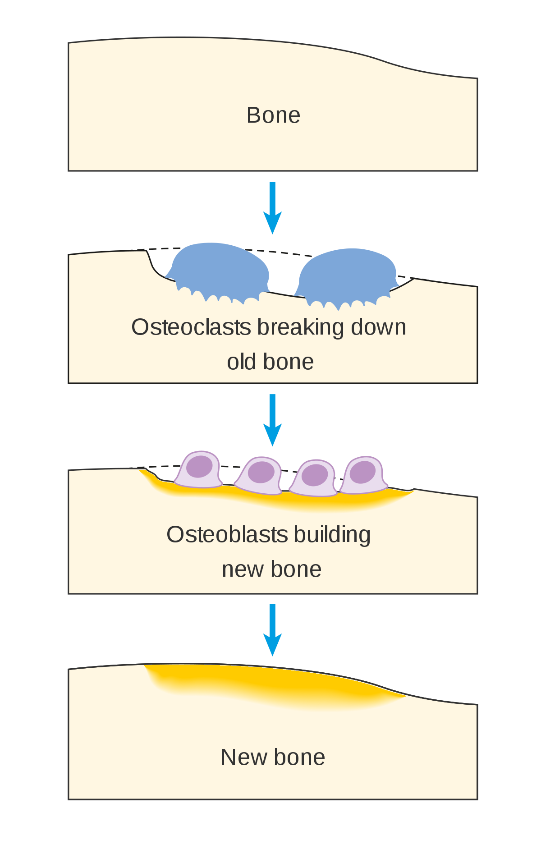
Bone remodeling
Bone remodeling involves the removal of mineralized bone by osteoclasts followed by the formation of bone matrix through the osteoblasts that subsequently become mineralized.

Slide 12
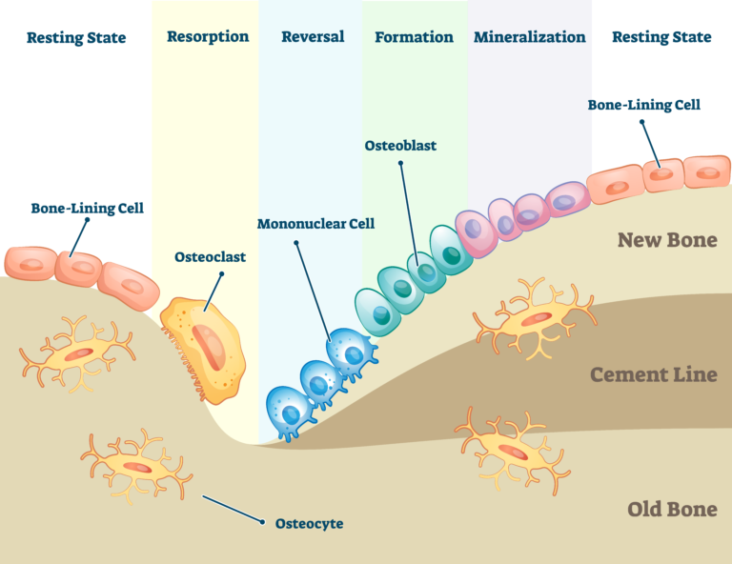
Bone remodelling

Slide 13
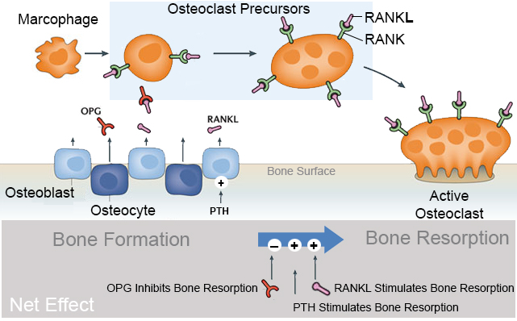
Bone remodelling
Osteoprotegerin :OPG
Receptor activator of NF-kB ligand (RANKL)
Receptor activator of NF-kB

Slide 14
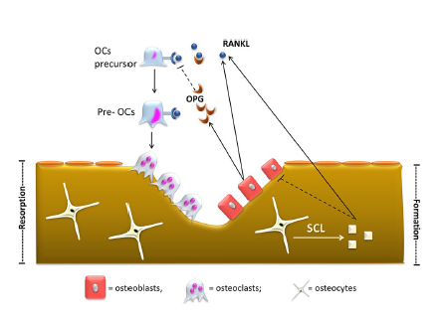
Bone Remodeling.
In physiologic condition, bone is continuously renewed through the coordinated process of bone resorption by osteoclasts and bone formation by osteoblasts
Receptor activator of NF‑κB ligand (RANKL) and osteoprotegerin (OPG), both produced by osteoblasts, are the key regulators of bone remodeling
RANK-L promotes the differentiation of osteoclasts’ precursor (OCs precursor) and pre-osteoclasts (Pre-OCs) in mature osteoclasts.
OPG, a high affinity ligand of RANK-L, acts as a soluble inhibitor of RANK-L thus reducing osteoclasts differentiation.
Osteocytes regulate bone turnover by secreting sclerostin (Scl).
Sclerostin reduces osteoblastogenesis promotes osteoblast and osteocyte apoptosis and, by inducing RANK-L synthesis, stimulates osteoclastogenesis
J Nephrol. 2017 Oct;30(5):689-699
J Nephrol . 2017 Oct;30(5):689-699

Slide 15
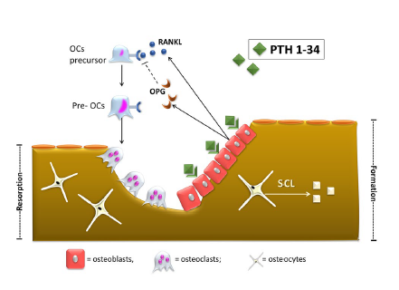
Effects of PTH 1–34 on bone.
Intermittent administration of recombinant human PTH 1–34 stimulates bone formation.
The positive effect of intermittent PTH on bone appears to be mediated through the PTH-1 receptor (PTH1R), expressed only in osteoblasts.
PTH1R activation increases osteoblasts’ number and activity.
However, osteoblasts activation by PTH increases receptor activator of NF‑κB ligand (RANK-L) synthesis and decreases osteoprotegerin (OPG) synthesis.
This, in turn, leads to new osteoclasts recruitment
and activation, thus balancing the two processes of bone formation and resorption.
However, the increment in bone formation occurs earlier
than that of bone resorption, thus increasing bone volume in the first months of therapy before osteoclast activation
J Nephrol . 2017 Oct;30(5):689-699

Slide 16
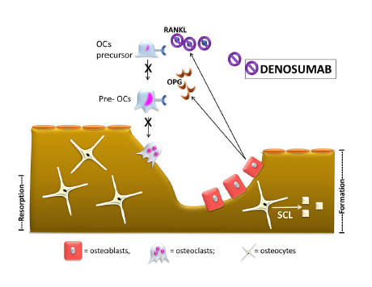
Effects of denosumab on bone.
Denosumab targets and binds receptor activator of NF‑κB ligand (RANK-L) with high affinity and specificity. RANK-L inhibition leads to suppression of osteoclasts differentiation, activity and survival.
The final effect is the reduction of bone resorption sites and increased bone volume
J Nephrol . 2017 Oct;30(5):689-699

Slide 17
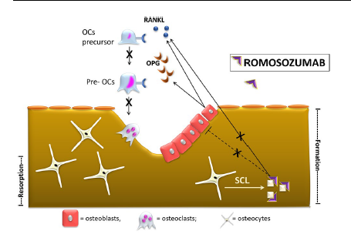
Effects of Romosozumab on bone.
Romosozumab targets and binds sclerostin (Scl). Physiologically, Scl reduces osteoblastogenesis and promotes osteoclastogenesis.
Thus, Scl inhibition leads to both anabolic (increased osteoblast activation) and anti-resorptive (reduced
osteoclastogenesis) effects
J Nephrol 2017 Oct;30(5):689-699

Slide 18
Pathophysiology
Osteoporosis
Corticosteroid-Induced Osteoporosis
Transplantation Osteoporosis
Tumour Therapy-Induced Osteoporosis (Prostate cancer and breast cancer on Aromatase inhibitors )
Postmenopausal osteoporosis

Slide 19
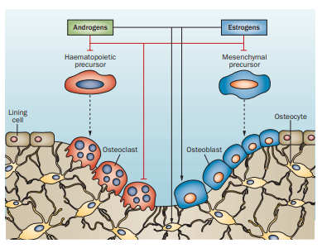
Postmenopausal osteoporosis
Red arrows : Inhibition
Back Arrow : Stimulation

Slide 20
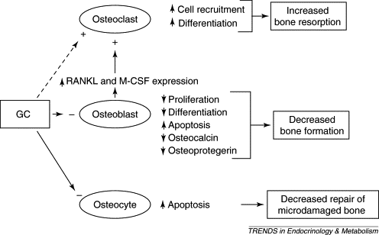
GC induced osteoporosis

Slide 21
CKD , Hyperparathyroidism , Osteoporosis
GFR falls below 45–50 mL/min/1.73 m²
Leads to phosphate retention
Hyperphosphatemia
GFR falls below 45–50 mL/min/1.73 m2
Low Activated Vitamin D3
Low calcium absorption
Hypocalcemia
Secretion of Fibroblast growth factor-23 by osteocyte
Secretion of PTH by parathyroid hormone
Phosphate excretion from Kindney and Vitamin D3 inhibition
Secondary hyperparathyroidism

Slide 22
PTH : Continuous stimulation vs Intermittent stimulation of osteoblast
Secondary hyperparathyroidism
PTH Secretions
Forms active Vit D3 through Kidneys
Osteoblast stimulation
Osteoclast stimulation
Vitamin D3 stimulates Intestinal calcium and phosphate absorption
Bone resorption
Osteoporosis
Calcium and phosphate released in the blood
Hypocalcemia corrected

Slide 23
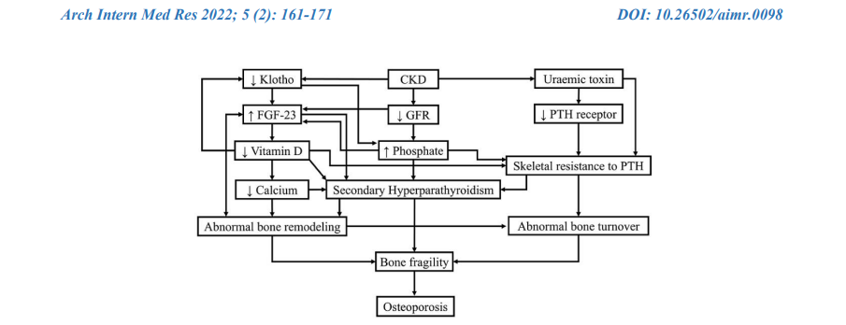
One of the earliest biomarkers of CKD appears to be a decreased expression in α-Klotho, which is a co-receptor of the phosphatonin Fibroblast growth factor 23 (FGF-23) .This peptide is secreted by osteocytes and osteoblasts in response to elevated phosphate and calcitriol levels thus allowing for increased excretion of phosphate. The resistance to FGF-23 by the decreased expression of α-Klotho leads to an increase in FGF-23 production, a decrease in calcitriol, relative hypocalcemia, and secondary hyperparathyroidism. his cascade eventually results in PTH receptor down-regulation with subsequent skeletal resistance to PTH action J Clin Transl Endocrinol. 2016 Sep; 5: 32–35.

Slide 24
(A) decrease clearance of FGF-23
(B) decrease phosphaturic effect of FGF-23
(C) inhibit 1-hydroxylase in proximal tubule of kidney
(D) increase renal tubular resorption of phosphate
(E) induce hypocalcemia, decrease calcitriol, increase PTH gene expression and PTH secretion
(F) decrease its inhibitory effect of due to decreased FGFR1 and kloth protein
(G) inhibit 1-hydroxylase
(H) Decrease intestinal absorption of Ca and decrease Ca release from bone
(I) decrease number of VDRs in parathyroid cells and decrease its inhibitory effect on parathyroid gland
(J) Increase PTH mRNA concentration and decreased expression of the calcium-sensing receptor (CaSR) on parathyroid gland
(K) Indoxyl sulfate decreases the expression of PTH1 receptor
(L) the physicochemical precipitation of inorganic phosphate and calcium can indirectly give rise to skeletal resistance to PTH (M) Indoxyl sulfate increases CpG hypermethylation of the Kloth gene
(N) P-cresyl sulfate induces osteoblastic dysfunction
Int. J. Mol. Sci. 2020, 21, 6846; doi:10.3390/ijms21186846

Slide 25
Adynamic bone disease Vs Dynamic bone disease
Adynamic bone disease is a form of CKD-MBD characterized by low bone turnover and low bone formation
Characterized by markedly low-bone turnover resulting from a reduced number of osteoclasts and osteoblasts
Due to either the resistance of parathyroid hormone (PTH) on bone metabolism or the over suppression of PTH release
ABD is a disease process caused by both PTH resistance and relative PTH deficiency
Downregulation of PTH receptors in bone cells
In patients with CKD stages 3–5, there is an 18% prevalence of ABD
Low-bone-turnover disease is seen in 50% of patients with CKD-MBD who receive peritoneal dialysis and in 19% of CKD-MBD patients receiving hemodialysis
Bone alkaline phosphatase (BAP) is the most useful parameter for bone formation as elevated levels
J Clin Transl Endocrinol. 2016 Sep; 5: 32–35.

Slide 26
Adynamic bone disease Vs Dynamic bone disease
Bone biopsy a gold standard
PTH levels <150 pg/mL
BSAP <12.9 ng/mL
J Clin Transl Endocrinol. 2016 Sep; 5: 32–35.

Slide 27
Continuous PTH vs Pulsatile PTH
In the skeleton, PTH increases the rate of bone remodelling, and its action becomes anabolic when its excretion is pulsatile, and catabolic when the bone is exposed to continuously high PTH levels.1
Continuous PTH stimulation causes both bone formation and bone resorption2
Pulsatile PTH causes bone formation earlies than bone resorption2
Intermittent PTH treatment increases osteoblast numbers, induces differentiation of committed osteoblast precursors and prolongs osteoblast survival3
J Bone Metab. 2020 Feb; 27(1): 1–13
Nat Rev Drug Discov 2, 257–258 (2003).
Nat Rev Endocrinol 7, 647–656 (2011).

Slide 28
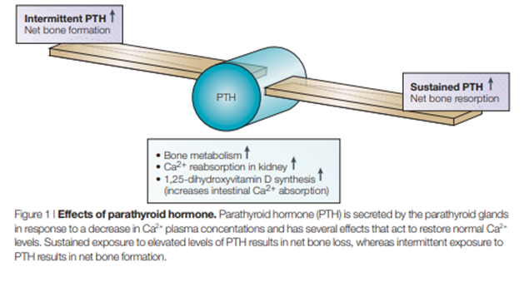

Slide 29
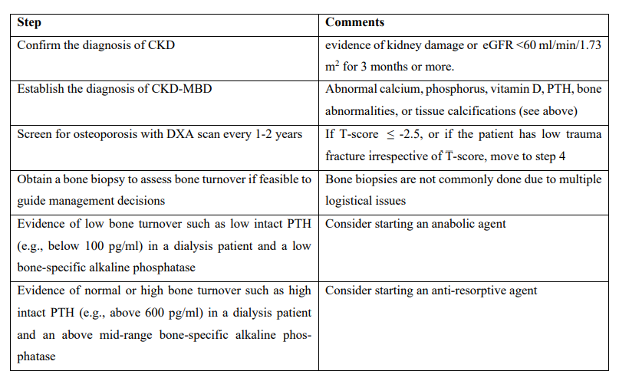
Table 5: Bone-specific alkaline phosphatase (BAP) is synthesized by the osteoblasts; reference range is approximately 7-27mcg/L. Intact parathyroid hormone (PTH) reference range is 10-65 pg/ml. KDIGO guidelines recommend maintaining intact PTH in the range of 2-9 times the upper range of normal in dialysis patients. A low intact PTH (e.g., below 100 pg/ml) in a dialysis patient is consistent with low bone turnover state such as adynamic bone disease, while a high intact PTH (e.g., above 600 pg/ml) is consistent with high bone turnover state such as secondary hyperparathyroidism
Arch Intern Med Res 2022; 5 (2): 161-171

Slide 30
Teriparatide
Recombinant human parathyroid hormone analog (PTH 1-34).
Identical sequence to the 34 N-terminal amino acids (the biologically active region) of the 84-amino acid human parathyroid hormone.
Each cartridge, pre-assembled into a delivery device, delivers 20 mcg of teriparatide per dose each day for up to 28 days

Slide 31
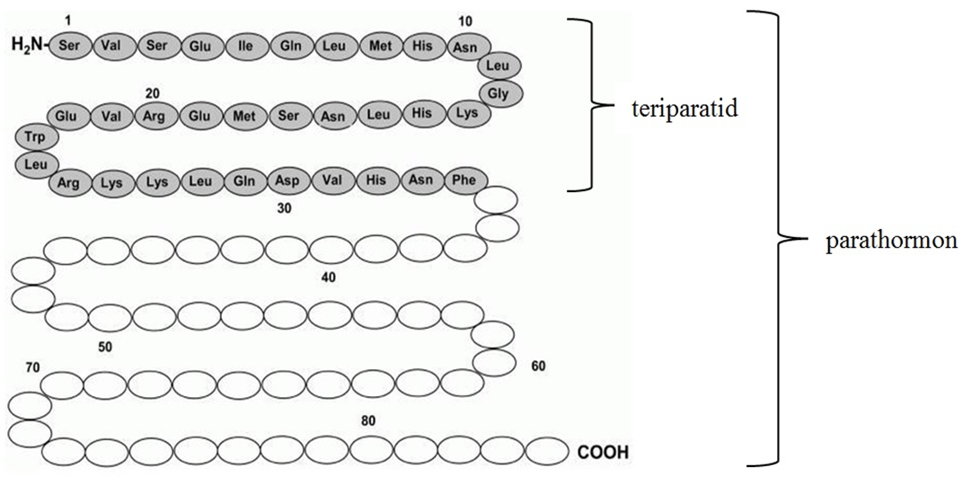

Slide 32
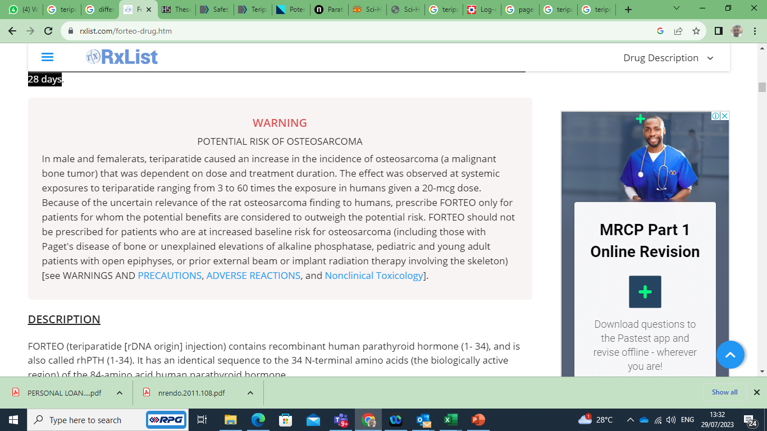
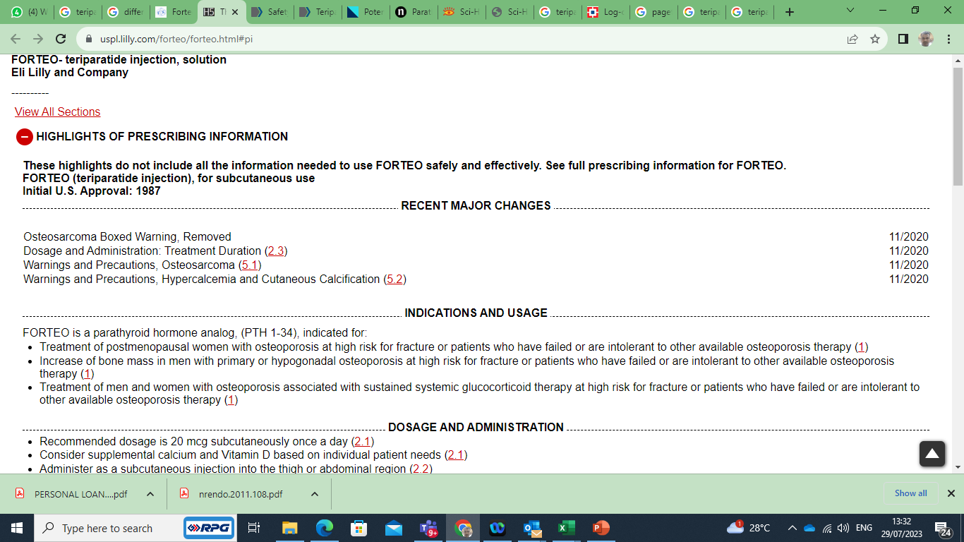

Slide 33
Indications
Treatment of postmenopausal women with osteoporosis
Increase of bone mass in men with primary or hypogonadal osteoporosis
Treatment of men and women with osteoporosis associated with sustained systemic glucocorticoid therapy
High risk for fracture
Patients who have failed or are intolerant to other available osteoporosis therapy

Slide 34
Dosage
Recommended dosage is 20 mcg subcutaneously once a day
Consider supplemental calcium and Vitamin D based on individual patient needs
Administer as a subcutaneous injection into the thigh or abdominal region
Administer initially when the patient can sit or lie down if symptoms of orthostatic hypotension occur
Use for more than 2 years during a patient's lifetime should only be considered if a patient remains at or has returned to having a high risk for fracture

Slide 35
Contraindication
Recommended dosage is 20 mcg subcutaneously once a day
Consider supplemental calcium and Vitamin D based on individual patient needs
Administer as a subcutaneous injection into the thigh or abdominal region
Administer initially when the patient can sit or lie down if symptoms of orthostatic hypotension occur
Use for more than 2 years during a patient's lifetime should only be considered if a patient remains at or has returned to having a high risk for fracture

Slide 36
Contraindication
Patients with hypersensitivity to teriparatide or to any of its excipients

Slide 37
Warnings and precautions
Osteosarcoma
Avoid use in patients with increased risk of osteosarcoma including patients with open epiphyses, metabolic bone diseases including Paget's disease, bone metastases
History of skeletal malignancies, prior external beam or implant radiation therapy involving the skeleton
Hereditary disorders predisposing to osteosarcoma.
Hypercalcemia and Cutaneous Calcification
Avoid in patients known to have an underlying hypercalcemic disorder.
Discontinue in patients developing worsening of previously stable cutaneous calcification.
Risk of Urolithiasis
Consider the risk/benefit in patients with active or recent urolithiasis because of risk of exacerbation
Orthostatic Hypotension
Transient orthostatic hypotension may occur with initial doses

Slide 38
Adverse reactions
Most common adverse reactions (>10%) include arthralgia, pain, and nausea

Slide 39
Use in specific population
Pregnancy
Consider discontinuing when pregnancy is recognized
Lactation
Breastfeeding is not recommended
Pediatric Use
Safety and effectiveness not established.
Avoid use due to increased baseline risk of osteosarcoma
Hepatic Impairment
No studies have been performed in patients with hepatic impairment
Renal Impairment
Severe renal impairment (CrCl<30 mL/minute), the AUC and T1/2 of teriparatide were increased by 73% and 77%, respectively.
Maximum serum concentration of teriparatide was not increased.

Slide 40

Monitoring
Serum calcium measurements at one month of treatment
If hypercalcemia is present, the dose of supplemental calcium should be reduced first
If it does not return to baseline, treatment should be administered every other day
If it persists, treatment should be discontinued, and the patient should undergo a diagnostic investigation to determine the cause of hypercalcemia.
BMD requires evaluation 1-year post first dose.
Before starting treatment, serum and urinary calcium should be measured because both hypercalcemia and hypercalciuria constitute contraindications to recombinant PTH therapy.
https://www.ncbi.nlm.nih.gov/books/NBK559248/#

Slide 41
Mechanism of Action
Teriparatide and the 34 N-terminal amino acids of PTH bind to receptors
Renal tubular reabsorption of calcium and phosphate, and intestinal calcium absorption
Stimulates new bone formation on trabecular and cortical (periosteal and/or endosteal) bone surfaces
Preferential stimulation of osteoblastic activity over osteoclastic activity
Increase in skeletal mass, an increase in markers of bone formation and resorption, and an increase in bone strength.
By contrast, continuous excess of endogenous PTH, as occurs in hyperparathyroidism, may be detrimental to the skeleton because bone resorption may be stimulated more than bone formation.

Slide 42
Pharmacodynamics
Known actions of endogenous PTH (e.g., increases serum calcium and decreases serum phosphorus).
Serum Calcium Concentrations : increased transiently, beginning approximately 2 hours after dosing and reaching a maximum concentration between 4 and 6 hours (median increase, 0.4 mg/dL).
The serum calcium concentration began to decline approximately 6 hours after dosing and returned to baseline by 16 to 24 hours after each dose.
Phosphorus and Vitamin D — In single-dose studies, teriparatide produced transient phosphaturia and mild transient reductions in serum phosphorus concentration

Slide 43
Pharmacodynamics
Effects on Markers of Bone Turnover
increases in the formation markers serum bone-specific alkaline phosphatase (BSAP) and procollagen I carboxy-terminal propeptide (PICP).
Peak concentrations of PICP at 1 month of treatment were approximately 41% above baseline, followed by a decline to near-baseline values by 12 months.
BSAP concentrations increased by 1 month of treatment and continued to rise more slowly from 6 through 12 months.
The maximum increases of BSAP were 45% above baseline in women and 23% in men. After discontinuation of therapy, BSAP concentrations returned toward baseline.

Slide 44
Pharmacokinetics
Absorption
95%
Peak serum concentrations :30 minutes
Declines within 3 hours.
Half-life
1 hour

Slide 45
Landmark studies

Slide 46
Decreases the risk of vertebral and nonvertebral fractures; increases vertebral, femoral, and total-body bone mineral density in postmenopausal women with osteoporosis
1637 postmenopausal women with prior vertebral fractures
20 or 40 microg of parathyroid hormone (1-34) or placebo,
Median duration of observation of 21 months
Vertebral fracture relative risk reduction : - 65% and – 69%
New nonvertebral fragility fractures: - 53% and -54%
BMD increased
Lumbar spine : More increased by 9% and 13 % ()
Femoral neck : More increased by 3% and 6 %
Minor side effects (occasional nausea and headache).
N Engl J Med . 2001 May 10;344(19):1434-41.

Slide 47
Increase in bone mineral density and is a potentially useful therapy for osteoporosis in men.
437 men with spine or hip bone mineral density > 2 SD below the young adult
Placebo , teriparatide 20 microg, or teriparatide 40 microg.
Supplemental calcium and vitamin D.
Median duration of 11 months
Spine bone mineral density was greater than in placebo subjects after 3 months of teriparatide therapy, and by the end of therapy it was increased by 5.9% (20 microg) and 9.0% (40 microg) above baseline (p < 0.001 vs. placebo for both comparisons).
Femoral neck bone mineral density increased 1.5% (20 microg; p = 0.029) and 2.9% (40 microg; p < 0.001), and whole-body bone mineral content increased 0.6% (20 microg; p = 0.021) and 0.9% (40 microg;p = 0.005) above baseline in the teriparatide subjects.
Adverse events were similar in the placebo and 20-microg groups, but more frequent in the 40-microg group.
J Bone Miner Res. 2003 Jan;18(1):9-17

Slide 48
Glucocorticoid-induced OP treated with teriparatide for 36 months had greater increases in BMD and fewer new vertebral fractures than subjects treated with alendronate.
teriparatide (20 microg/day) vs antiresorptive drug alendronate (10 mg/day) for treating glucocorticoid-induced osteoporosis (OP).
36-month, 428 subjects
Received > or =5 mg/day of prednisone equivalent for > or =3 months preceding screening.
Increases in BMD from baseline were significantly greater in the teriparatide group than in the alendronate group, and at 36 months were 11.0% versus 5.3% for lumbar spine, 5.2% versus 2.7% for total hip, and 6.3% versus 3.4% for femoral neck (P < 0.001 for all).
Fewer subjects had vertebral fractures in the teriparatide group than in the alendronate group (3 [1.7%] of 173 versus 13 [7.7%] of 169; P = 0.007), with most occurring during the first 18 months.
There was no significant difference between groups in the incidence of nonvertebral fractures (16 [7.5%] of 214 subjects taking teriparatide versus 15 [7.0%] of 214 subjects taking alendronate; P = 0.843).
Arthritis Rheum. 2009 Nov;60(11):3346-55

Slide 49
Clinical overview
Glucocorticoid induced (J Clin Endocrinol Metab. 2020 Jan 1;105(1):dgz023)
19 unique trials involving 4328 patients receiving GCs
Teriparatide (risk ratio [RR] 0.11, 95% confidence interval [CI] 0.03-0.47), denosumab (RR 0.21, 95% CI 0.09-0.49), and risedronate (RR 0.33, 95% CI 0.19-0.58) reduced the risk of GI vertebral fractures
In terms of clinical efficacy and safety, second-line teriparatide and denosumab pose a challenge to first-line oral bisphosphonates for prevention of GI fractures

Slide 50
Teriparatide and denosumab, alone or combined, in women with postmenopausal osteoporosis: the DATA study randomised trial
Patients were assigned in a 1:1:1 ratio to receive 20 μg teriparatide daily, 60 mg denosumab every 6 months, or both. BMD was measured at 0, 3, 6, and 12 months
At 12 months, posterior-anterior lumbar spine BMD increased more in the combination group (9·1%, [SD 3·9]) than in the teriparatide (6·2% [4·6], p=0·0139) or denosumab (5·5% [3·3], p=0·0005) groups.
Femoral-neck BMD also increased more in the combination group (4·2% [3·0]) than in the teriparatide (0·8% [4·1], p=0·0007) and denosumab (2·1% [3·8], p=0·0238) groups, as did total-hip BMD (combination, 4·9% [2·9]; teriparatide, 0·7% [2·7], p<0·0001; denosumab 2·5% [2·6], p=0·0011).
Combined teriparatide and denosumab increased BMD more than either agent alone and more than has been reported with approved therapies. Combination treatment might, therefore, be useful to treat patients at high risk of fracture.
Lancet. 2013 Jul 6;382(9886):50-6.

Slide 51
Clinical efficacy of denosumab, teriparatide, and oral bisphosphonates in the prevention of glucocorticoid-induced osteoporosis: a systematic review and meta-analysis
10 studies involving 2923 patients who received GCs
Teriparatide and denosumab were superior to bisphosphonates in increasing the bone mineral density (BMD) of the lumbar vertebrae [teriparatide: mean difference [MD] 3.98%, 95% confidence interval [CI] 3.61-4.175%, P = 0.00001; denosumab: MD 2.07%, 95% CI 0.97-3.17%, P = 0.0002].
Teriparatide was superior to bisphosphonates in preventing vertebral fractures and increasing hip BMD [MD 2.39%, 95% CI 1.47-3.32, P < 0.00001].
There was no statistically significant difference between serious adverse events, adverse events, and nonvertebral fracture prevention drugs.
Teriparatide and denosumab exhibited similar or even superior characteristics to bisphosphonates
Potential to become first-line GC-induced osteoporosis treatments, especially for patients who have previously received other anti-osteoporotic drugs with poor efficacy.
J Orthop Surg Res. 2023 Jun 22;18(1):447

Slide 52
Is Abaloparatide more efficacious on increasing bone mineral density than teriparatide for women with postmenopausal osteoporosis? An updated meta-analysis
Four studies
All parameters in 24 weeks except lumbar spine (versus TPTD) showed significant advantages in the ABL group.
Only the results of two subgroups in ABL versus TPTD demonstrated High GRADE quality (femoral
Incidence of hypercalcemia in the ABL group lessened by 51% compared with the TPTD group. Nevertheless, compared with placebo, ABL demonstrated higher risks of nausea and palpitations.
ABL demonstrated a beneficial effect on BMD compared to both placebo and TPTD for postmenopausal women with osteoporosis.
ABL also had insignificantly lowered adverse event risk than TPTD. ABL is an alternative for patients with postmenopausal osteoporosis.
J Orthop Surg Res. 2023 Feb 17;18(1):116.

Slide 53
Potential effects of teriparatide (PTH (1-34)) on osteoarthritis: a systematic review
33 studies were included.
In vivo studies (n = 22) concluded that PTH (1-34) slowed progression of OA by alleviating cartilage degeneration and aberrant remodeling of subchondral bone (SCB).
Moreover, PTH (1-34) exhibited repair of cartilage and SCB, analgesic, and anti-inflammatory effects.
In vitro studies (n = 11) concluded that PTH (1-34) was important for chondrocytes via increasing the proliferation and matrix synthesis but preventing apoptosis or hypertrophy.
PTH (1-34) could alleviate the progression of OA.
Moreover, PTH (1-34) had beneficial effects on osteoporotic OA (OPOA) models, which might be a therapeutic option for OA and OPOA treatment.
Arthritis Res Ther. 2023 Jan 6;25(1):3.

Slide 54
Efficacy of the Combination of Teriparatide and Denosumab in the Treatment of Postmenopausal Osteoporosis: A Meta-Analysis
Overall, combination treatment enhanced the mean percent change of bone mineral density in lumbar spine than monotherapy (WMD = 2.91, 95%CI: 1.983.83; p = 0.00).
combination treatment has been beneficial for enhancing the mean percent change of BMD in hip (WMD = 3.19, 95%CI: 2.25∼4.13; p = 0.00).
There was no significant difference between combination treatment and monotherapy in terms of the adverse events (RR = 0.81, 95%CI: 0.45∼1.45; p = 0.472).
The meta-analysis indicates that combination treatment led to greater BMD at the lumbar spine and hip in comparison to monotherapy, without an increased incidence of adverse events.
Front Pharmacol. 2022 May 24;13:888208.

Slide 55
The efficiency and safety of alendronate versus teriparatide for treatment glucocorticoid-induced osteoporosis: A meta-analysis and systematic review of randomized controlled trials
A total of 4102 patients were enrolled in all 5 studies
compared with ALE, TPTD could reduce the rate of new vertebral fracture (RR = 0.13, 95% CI: 0.05-0.34, P<0.00001).
TPTD increased LS bone mineral density (BMD) (0.53, 95% CI 0.42-0.64, P<0.00001), TH BMD (0.17, 95% CI 0.05-0.28, P = 0.004) and FN BMD (0.17, 95% CI 0.05-0.29, P = 0.006) compared to ALE.
However, there was no significant difference in the incidence of non-vertebral fracture and adverse events between the two groups.
Compared with ALE, TPTD is an effective drug to reduce vertebral fracture risk in patients with GIOP.
Furthermore, long-term use of TPTD can increase the bone mineral density of LS, FN, and TH.
PLoS One. 2022 May 31;17(5):e0267706

Slide 56
Efficacy of Osteoporosis Medications for Patients With Chronic Kidney Disease: An Updated Systematic Review and Network Meta-Analysis
Patients with CKD or a history of kidney transplantation
17 studies with data from 10,214 patients who had stage 2-5 CKD, were receiving dialysis, or had a history of kidney transplantation
Reduced risk of fractures vs placebo
Teriparatide: odds ratio (OR) = 0.19, 95% confidence interval (CI): 0.10-0.35
Denosumab: OR = 0.40, 95% CI: 0.27-0.58
Alendronate: OR = 0.61, 95% CI: 0.40-0.92
Raloxifene: OR = 0.52, 95% CI: 0.41-0.67]
Rank probability and the surface under the cumulative ranking (SUCRA) values
Teriparatide ranked the highest for improvement in vertebral bone mineral density (BMD) (SUCRA = 97.8%)
Denosumab ranked the highest for improvement in femoral neck BMD (SUCRA = 88.3%).
Chia-Hsien Chen et al., Front Pharmacol. 2022 Feb 11;13:822178

Slide 57
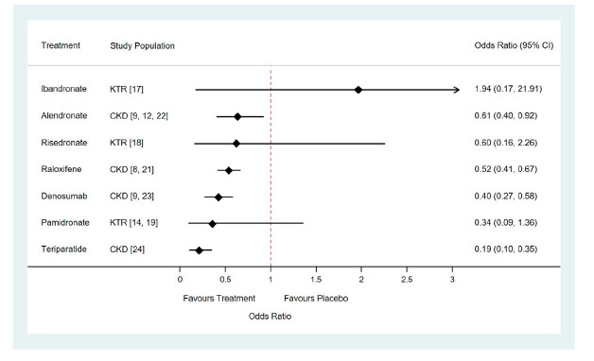
Teriparatide and denosumab seem to be the most effective treatments for preventing bone loss and reducing the risk of fracture in network comparison
Forest plots of relative risk of vertebral or clinical fractures of seven drugs for the treatment of osteoporosis compared with placebo in patients with chronic kidney disease or underwent kidney transplantation. Abbreviation: CKD, Chronic Kidney Disease; KTR, Kidney Transplant Recipients
Chia-Hsien Chen et al., Front Pharmacol. 2022 Feb 11;13:822178

Slide 58
Pharmacological interventions versus placebo, no treatment or usual care for osteoporosis in people with chronic kidney disease stages 3-5D
7 studies involving 9164 randomised participants with osteoporosis and CKD stages 3 to 5D
Anti-osteoporotic drugs may reduce the risk of vertebral fracture (RR 0.52, 95% CI 0.39 to 0.69; low certainty evidence).
Anti-osteoporotic drugs probably makes little or no difference to the risk of clinical fracture (RR 0.91, 95% CI 0.79 to 1.05; moderate certainty evidence) and adverse events (RR 0.99, 95% CI 0.98 to 1.00; moderate certainty evidence).
Among patients with CKD stages 3-4, anti-osteoporotic drugs may reduce the risk of vertebral fracture in low certainty evidence.
Cochrane Database Syst Rev. 2021 Jul 7;7(7):CD013424.

Slide 59
Comparative Chart
 | Denosumab | Bisphosphonate (Zoledronic acid ) | Romosozumab | Teriparatide
Dosage | 60 mg SQ every 6 months | 5 mg IV once yearly | 210 mg SQ monthly | 20 mcg SQ once a day
Renal impairment | Dosage adjustment not needed | Increased risk of renal toxicity Not recommended in severe renal impairment | Dosage adjustment not needed | Dosage adjustment not needed
MOA | RANKL antibody Antiresorptive | Bisphosphonate Antiresorptive | Anti-(human sclerostin) Anabolic and antiresorptive | Parathyroid Agents Anabolic
Adverse effects | Back and musculoskeletal pain , hypocalcemia | Increased risk of renal toxicity Not recommended in severe renal impairment | May increase risk of MI, stroke, and cardiovascular death. | Risk of osteosarcoma
Clinical studies | CKD : Meta analysis of 17 studies with 10214 patients , reduced fracture risk by Teriparatide (-81%), Denosumab (- 60%), Alendronate (-39%) and Raloxifene (-33%) (Front Pharmacol. 2022 Feb 11;13:822178)
Black box waring | No | No | Yes (MI and CVD) | Yes (Risk of osteosarcoma)

Slide 60
Comparative Chart
 | Denosumab | Bisphosphonate (Zoledronic acid ) | Romosozumab | Teriparatide
Hip fracture risk reduction | -44% | -40% | -56% | - | 107 trials (193,987 postmenopausal women; mean age, 66 years J Clin Endocrinol Metab, May 2019, 104(5):1623–1630
Non vertebral | -20% | -21% | -49% | -49%
Vertebral | -68% | -62% | -67% | -86%
Teriparatide, abaloparatide, denosumab, romosozumab, and most bisphosphonates appear to have the highest efficacy

Slide 61

Guidelines
Place in therapy

Slide 62
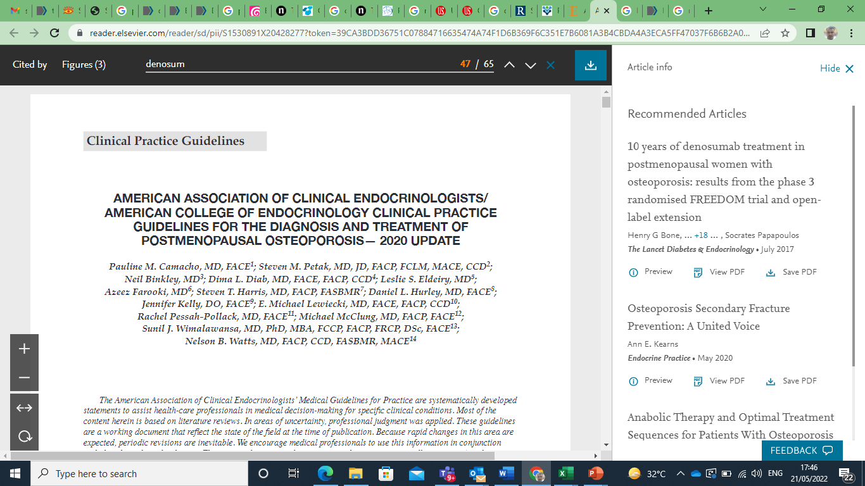
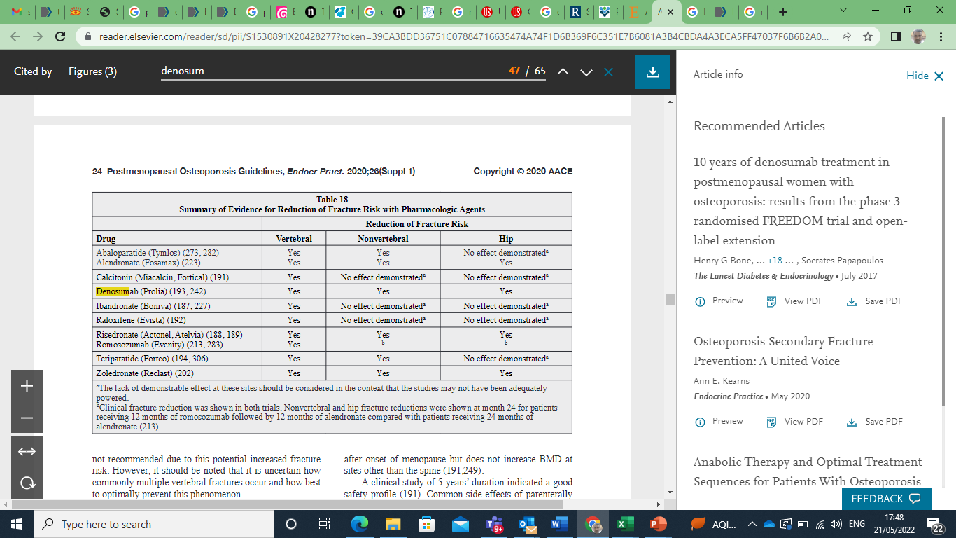

Slide 63
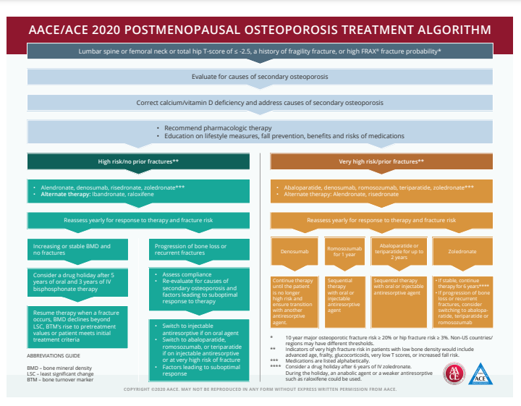

Slide 64
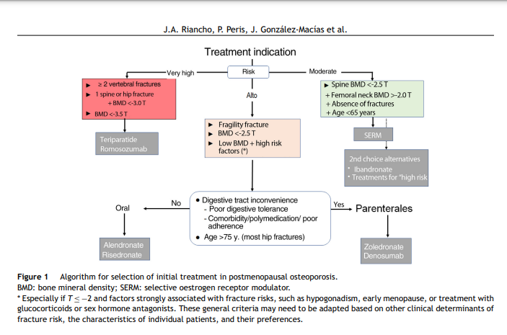

Slide 65
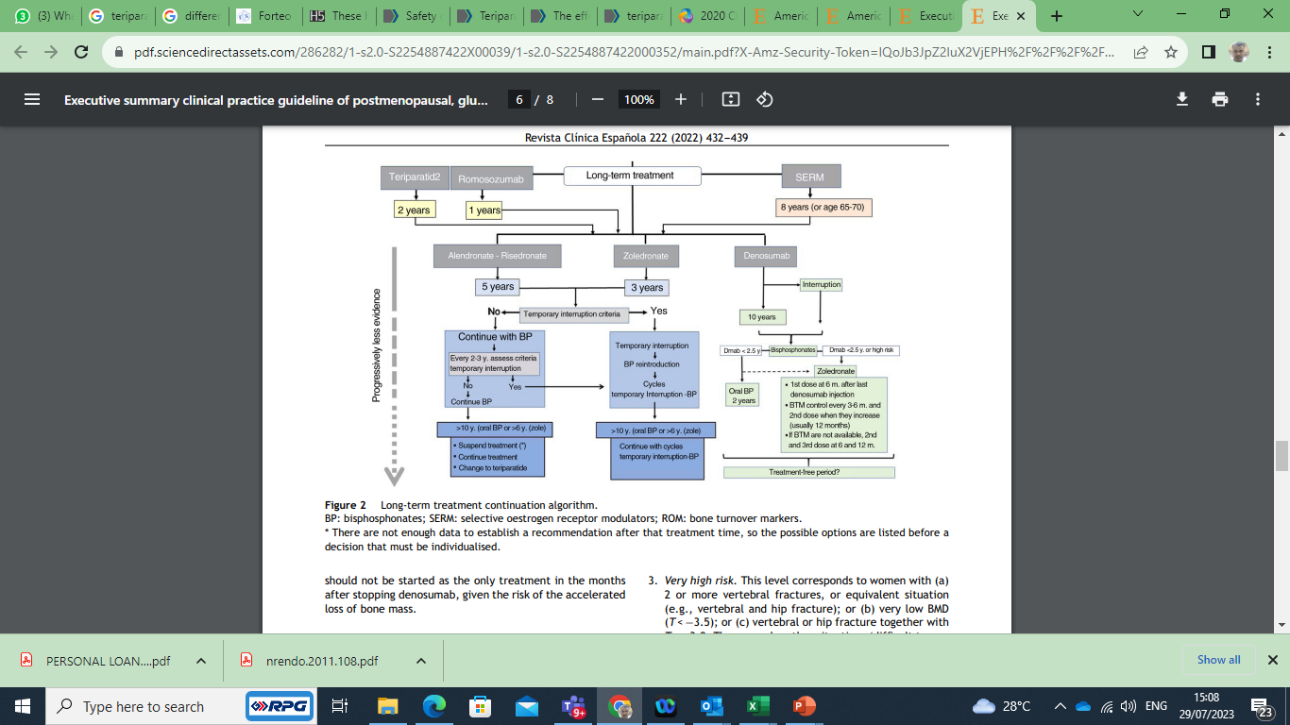
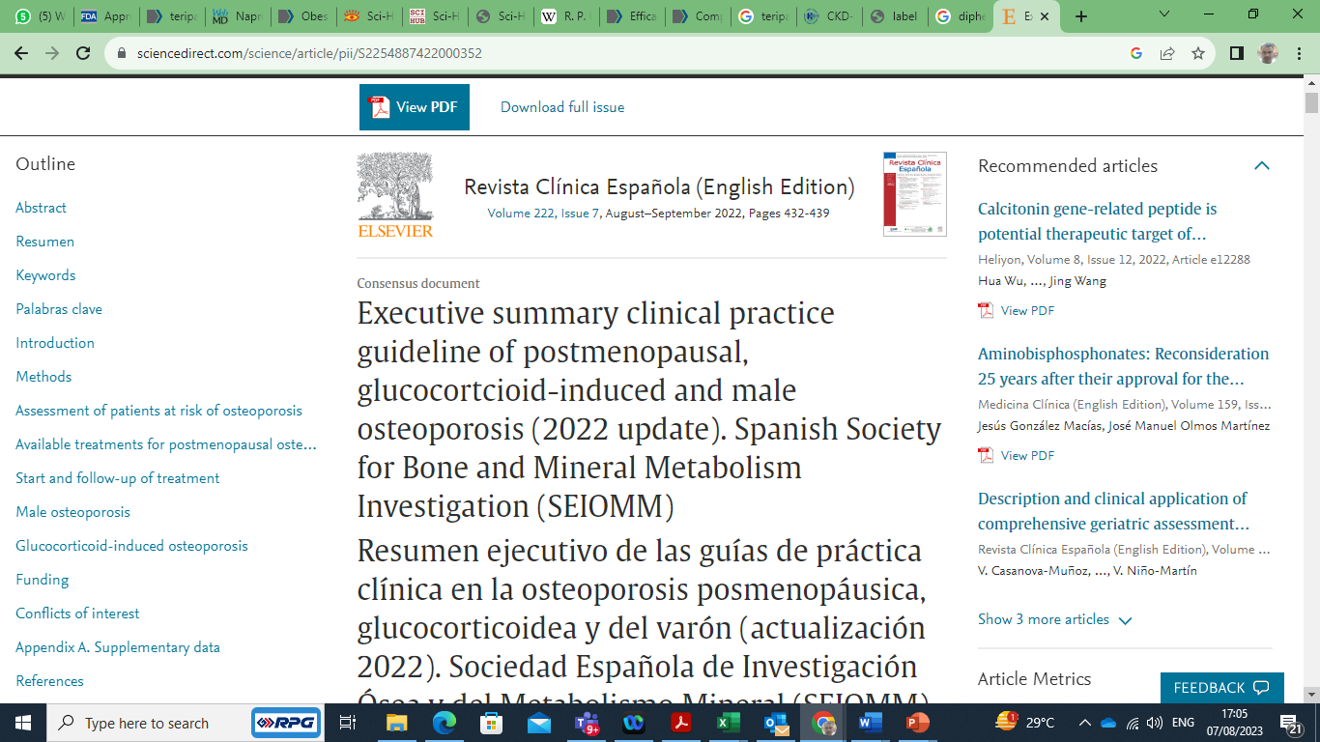
https://www.sciencedirect.com/science/article/pii/S2254887422000352

Slide 66
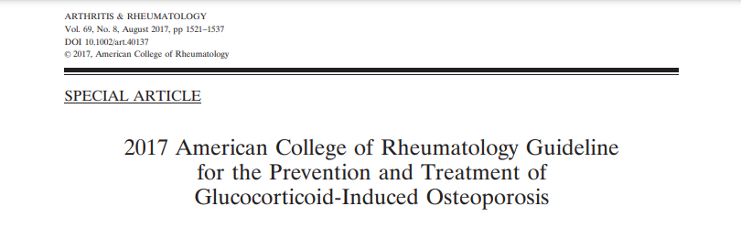

Slide 67
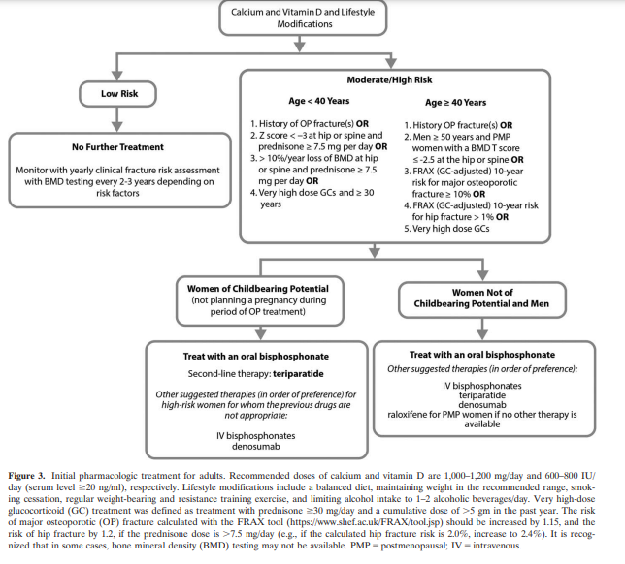

Slide 68
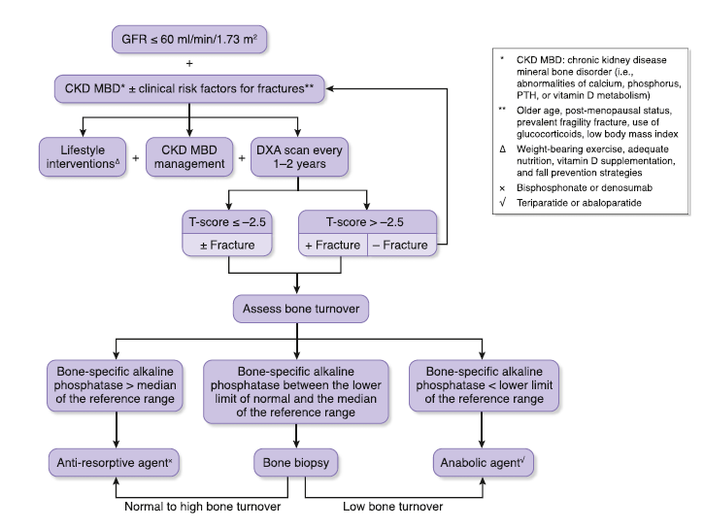
An algorithm for fracture risk screening and initiation of anti-fracture strategies in patients with CKD
Clin J Am Soc Nephrol 13: 962–969, 2018.

Slide 69
CKD
CKD stage 1–3 disease
CKD stage 4-5 disease
Kidney transplant bone disease
CKD G1–G2 with osteoporosis and/or high risk of fracture*
CKD G3a–G3b with PTH in the normal range and osteoporosis and/or high risk of fracture*
First 12 months
After12 months
As defined by the World Health Organization (WHO), osteoporosis is present when BMD is 2.5 SD or more below the average value (a T-score of <−2.5 SD).
eGFR > 30 ml/min/ 1.73 m2 and low BMD, treatment with vitamin D, calcitriol/alfacalcidol, and/or antiresorptive agents be considered
Insufficient data to guide on treatment after 12 months
Baseline serum calcium, phosphate, PTH, alkaline phosphatase (ALP), and 25 hydroxyvitamin D (25-OHD)
Normal
Antiresorptive medications as per usual osteoporosis guidelines
*Risk factors by 2020 AACE
Prior fracture without major trauma (other than fingers, toes, skull) after age 50 years | Clinical risk factors for osteoporosis Age ≥65 years Low body weight Smoking Early menopause Excessive alcohol intake | Prior spine fractures Glucocorticoid therapy equivalent to ≥5 mg of prednisone per day for 3months or more Secondary osteoporosis Height loss of kyphosis Risk factors for falling With radiographic osteopenia
Lifestyle modification • Nutrition • Vitamin D • Weight-bearing physical activity • Fall prevention • Cessation of smoking
Follow-up • Assess for compliance and side effects • BTMs to verify compliance • Beware of discontinuing denosumab
Executive summary of the 2017 KDIGO chronic kidney disease–mineral and bone disorder (CKD-MBD) guideline update

Slide 70
CKD
CKD stage 4-5 disease
High
Country-specific FRAX fracture possibility
DXA-based BMD at spine or hip: T ≤ –2.5
Fragility fractures (spine, hip, proximal humerus, pelvis or multiple)
Postmenopausal , Age > 50 years
Lateral imaging of spine
Vertebral fracture assessment
Bone biopsy
Suggested particularly in those with CKD stage 3a–5D
2017 update to the KDIGO guidelines emphasize that antiresorptive therapy should not be withheld for bone biopsy
KDIGO suggests, that if baseline serum calcium, phosphate, PTH, and 25-OHD are abnormal, the following might be considered
CKD–MBD and metabolic control
Hyperphosphatemia
Reduce dietary phosphate
If resistant, phosphate binders can be considered
In CKD stage 5, dialytic removal of phosphate can be used
Hypocalcemia
Serum calcium should be maintained within the reference range,
Vitamin D
Hyperparathyroidism
If PTH remains out of target despite correction of hypocalcemia, hyperphosphatemia, and use of vitamin D analogs, calcimimetics followed by parathyroidectomy might be considered
Rule out adynamic bone disease
Hemodialysis (HD) patients (in whom adynamic bone disease is particularly prevalent), bs- ALP < 20 μg/L (0.02 U/L) and PTH < 200 ng/L (21 pmol/L) had 100% sensitivity, 100% specificity, 100% PPV, and 84% NPV for adynamic bone disease
The use of antiresorptive medications in adynamic bone disease might worsen bone health
Normal or high bone turnover
Bone – specific alkaline phosphatase > median of the reference range
Range : 6.5-20.1 µg/L
Normal or high bone turnover
Bone – specific alkaline phosphatase between lower limit and median of reference range
Range : 6.5-20.1 µg/L
Low bone turnover
Bone specific alkaline phosphatase < lower limit of reference range
Range : 6.5-20.1 µg/L
Antiresorptive medications
Bone biopsy
Anabolic agent
) Executive summary of the 2017 KDIGO chronic kidney disease–mineral and bone disorder (CKD-MBD) guideline update
Clin J Am Soc Nephrol 13: 962–969, 2018

Slide 71

Summary
GFR falls below 45–50 mL/min/1.73 m2_ Low Activated Vitamin D3 _Low calcium absorption _ Hypocalcemia _Secretion of PTH by parathyroid hormone _Secondary hyperparathyroidism _ Osteoblast stimulation _ Osteoclast stimulation _ Bone resorption _ Calcium and phosphate released in the blood
PTH is secreted by parathyroid gland in response to the low calcium in the blood
Inhibits osteoblast activity and stimulates osteoclast activity leading to bone breakdown and calcium release
Bone remodeling involves the removal of mineralized bone by osteoclasts followed by the formation of bone matrix through the osteoblasts

Slide 72
Summary
Adynamic bone disease is a form of CKD-MBD characterized by low bone turnover and low bone formation (Diagnostic criteria PTH levels <150 pg/mL, BSAP <12.9 ng/mL )
Characterized by markedly low-bone turnover resulting from a reduced number of osteoclasts and osteoblasts
ABD is a disease process caused by both PTH resistance and relative PTH deficiency
In patients with CKD stages 3–5, there is an 18% prevalence of ABD
Low-bone-turnover disease is seen in 50% of patients with CKD-MBD who receive peritoneal dialysis and in 19% of CKD-MBD patients receiving hemodialysis

Slide 73
Summary
In the skeleton, PTH increases the rate of bone remodelling, and its action becomes anabolic when its excretion is pulsatile, and catabolic when the bone is exposed to continuously high PTH levels
Pulsatile PTH causes bone formation earlies than bone resorption2

Slide 74
Summary
Recombinant human parathyroid hormone analog (PTH 1-34).
TPT approved for post menopausal osteoporosis , men osteoporosis, GC osteoporosis , failed or are intolerant to other available osteoporosis therapy
Recommended dosage is 20 mcg subcutaneously once a day
Consider supplemental calcium and Vitamin D based on individual patient needs
Use for more than 2 years during a patient's lifetime should only be considered if a patient remains at or has returned to having a high risk for fracture
Most common adverse reactions (>10%) include arthralgia, pain, and nausea
Serum calcium measurements at one month of treatment

Slide 75
Summary
GC osteoporosis
19 unique trials involving 4328 patients
Vertebral fractures risk ratio TPT 0.11, denosumab 0.21, risedronate 0.33
J Clin Endocrinol Metab. 2020 Jan 1;105(1):dgz023
10 studies involving 2923 patients
Superior to BP in improving lumbar vertebrae BMD (3.98% vs2.07% Denosumab)
superior to bisphosphonates in preventing vertebral fractures and increasing hip BMD 2.39%
Potential to become first-line GC-induced osteoporosis treatments
J Orthop Surg Res. 2023 Jun 22;18(1):447
4102 patients, 5 studies
compared with ALE, TPTD could reduce the rate of new vertebral fracture (RR = 0.13) PLoS One. 2022 May 31;17(5):e0267706
ACR guidelines on GC osteoporosis
H/o fractures or Z < -3 or T< -2.5 or prednisolone 7.5 mg or very high dose of GC – first line is BP , second line is TPT or denosumab

Slide 76
Summary
Postmenopausal osteoporosis
DATA study: Femoral-neck BMD (combination group 4·2% vs TPT 0·8% vs Denosumab 2·1 %), total-hip BMD (combination group 4·9% vs TPT 0·7% vs 2·5% ) Lancet. 2013 Jul 6;382(9886):50-6
combination treatment enhanced the mean percent change of bone mineral density in lumbar spine and hip than monotherapy (2.91%, 3.19%) Front Pharmacol. 2022 May 24;13:888208
107 trials 193,987 patients (J Clin Endocrinol Metab, May 2019, 104(5):1623–1630)
Denosumab , Bisphosphonate (Zoledronic acid ), Romosozumab , Teriparatide
Hip fracture risk reduction -44% , -40%, -56%,
Non vertebral -20%, -21%, -49%, -49%
Vertebral - 68%, -62%, -67%, -86%

Slide 77
Summary
American association of clinical endocrinologist
Post menopausal osteoporosis guidelines
TPT recommended in very high risk and H/o fracture
After 2 years of TPT , antiresorptive oral or injectable is given
Initial treatment of postmenopausal Osteoporosis (https://www.sciencedirect.com/science/article/pii/S2254887422000352)
> vertebral fractures or 1 spine fracture or hip fracture + BMD < -3 T or BMD < -3.5 T , TPT is recommended

Slide 78
Summary
Osteoarthritis
33 studies
slowed progression of OA by alleviating cartilage degeneration and aberrant remodeling of subchondral bone
exhibited repair of cartilage and SCB
Arthritis Res Ther. 2023 Jan 6;25(1):3

Slide 79
Summary
CKD osteoporosis
17 studies with data from 10,214 patients who had stage 2-5 CKD, were receiving dialysis, or had a history of kidney transplantation
Reduced risk of fractures vs placebo
Teriparatide: odds ratio (OR) = 0.19, Denosumab: OR = 0.40, Alendronate: OR = 0.61, Raloxifene: OR = 0.52)
Teriparatide ranked the highest for improvement in vertebral bone mineral density (BMD) and denosumab for femoral neck BMD
Front Pharmacol. 2022 Feb 11;13:822178
Adynamic/ low bone turnover diseases: Diagnostic criteria PTH levels <150 pg/mL, BSAP <12.9 ng/mL: TPT recommended Clin J Am Soc Nephrol 13: 962–969, 2018

